Slide 1
The Intersection of Business and Big Data
James Liu

Slide 2
Disclaimer
Everything that I’m presenting tonight are my own thoughts and in no way represent AWS or Amazon.
All the data on the slides are public and can be found in the resources I referenced and online.

Slide 3

“Everything Starts with a Story…”
“Everything Starts with a Story…”
Joseph Campbell (1904 – 1987), American professor of literature, Author
Joseph Campbell (1904 – 1987), American professor of literature, Author
Notes:
George Lucas (Star Wars Fans) was inspired by Joseph Campbell an American Author that introduced the theory of the Hero’s journey.
I wanted to start with a story about the evolution of Data and how we use it…

Slide 4
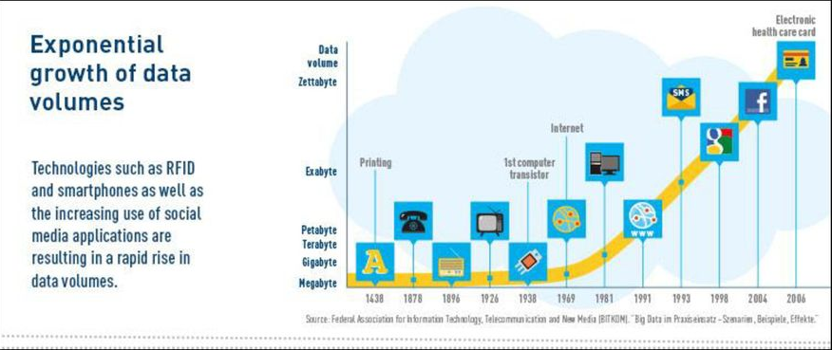
Source: http://ec1307560.blogspot.com/2018/10/2-historical-development-of-big-data.html; https://slideplayer.com/slide/12284579/
Notes:
In 1989 British computer scientist Tim Berners-Lee invented eventually the World Wide Web. He wanted to facilitate the sharing of information via a ‘hypertext’ system. Little could he know at the moment the impact of his invention.
As of the ‘90s, the creation of data is spurred as more and more devices are connected to the internet. In 1995 the first super-computer is built, which was able to do as much work in a second than a calculator operated by a single person can do in 30.000 years.
In 2011 the McKinsey report on Big Data: The next frontier for innovation, competition, and productivity, states In the past few years, there has been a massive increase in Big Data startups, all trying to deal with Big Data and helping organizations to understand Big Data and more and more companies are slowly adopting and moving towards Big Data.

Slide 5
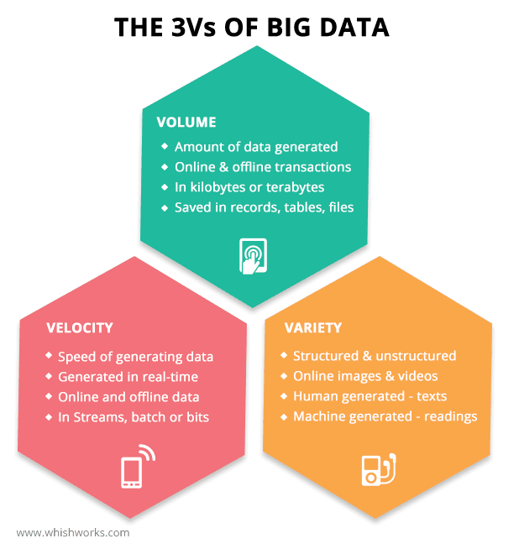
What exactly is big data?
Source: https://www.oracle.com/big-data/what-is-big-data/#:~:text=The%20definition%20of%20big%20data,especially%20from%20new%20data%20sources.
Notes:
The definition of big data is data that contains greater variety, arriving in increasing volumes and with more velocity. This is also known as the three Vs.
Structured data is a standardized format for providing information about a page and classifying the page content; for example, on a recipe page, what are the ingredients, the cooking time and temperature, the calories, and so on.
Put simply, big data is larger, more complex data sets, especially from new data sources. These data sets are so voluminous that traditional data processing software just can’t manage them. But these massive volumes of data can be used to address business problems you wouldn’t have been able to tackle before.
In 2010 Eric Schmidt speaks at the Techonomy conference in Lake Tahoe in California and he states that "there were 5 exabytes of information created by the entire world between the dawn of civilization and 2003. Now that same amount is created every two days."

Slide 6
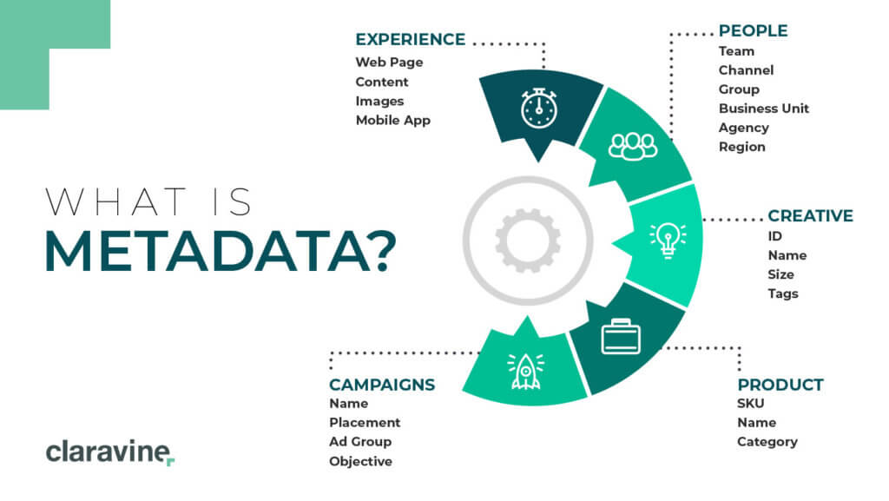
How Businesses Use the Data?
Notes:
It is with metadata that we can see the “larger picture” of what is going on in the systems and components of information processing.
Examples of structured data include names, dates, addresses, credit card numbers, stock information, geolocation, and more.
Structured data is highly organized and easily understood by machine language.
Unstructured data is most often categorized as qualitative data, and it cannot be processed and analyzed using conventional data tools and methods.
Examples of unstructured data include text, video files, audio files, mobile activity, social media posts, satellite imagery, surveillance imagery – the list goes on and on.
Unstructured data is difficult to deconstruct because it has no predefined data model, meaning it cannot be organized in relational databases.

Slide 7
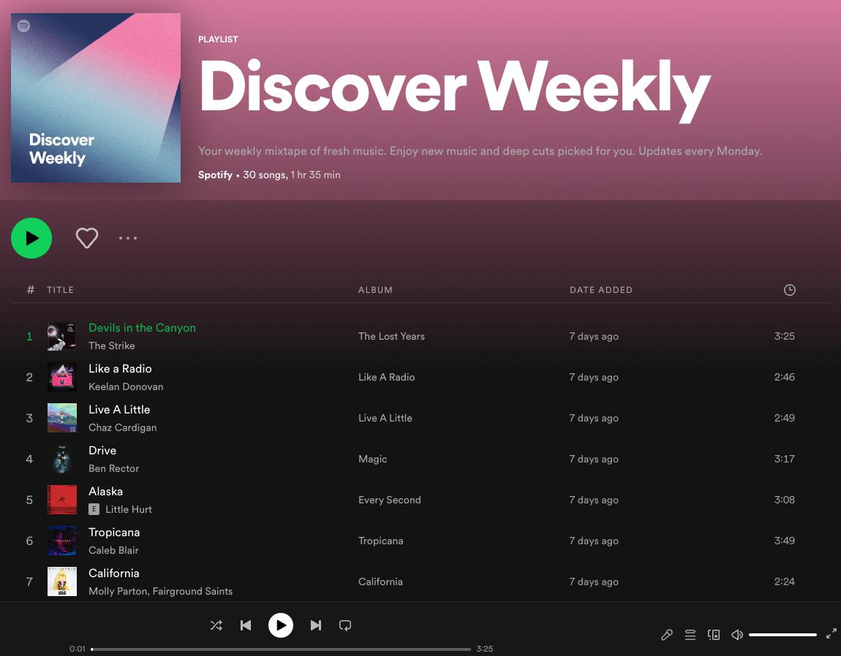
How Spotify uses Data to Power a Product…
Users create playlists
You listen to and save songs
Identifies similar songs that appear in user created playlists
Spotify develops your “taste profile”
Spotify Algorithm finds songs that fit your profile but that you have not listen to…
Source: Swipe to Unlock
Notes:
Every week Spotify sends listeners a playlist of 30 songs that are almost perfectly tuned to their musical taste. Each year they create
Looks at the songs you listen to and liked enough to add to your library or playlist
Discards the songs you skipped within the first 30 seconds
Leverage the playlist other people have made with the assumption that every playlist has some thematic connection.
Once it has this data Spotify uses two methods to find songs you might light – For instance, suppose someone made a playlist with 10 songs, 9 ofthose are in your library, discover weekly might reconned the one song that isn’t in your library. This methods is called “Collaborative filtering” – same logic that YouTube and Netflix uses to recommend video suggestions.
Second method that spotify uses to make your playlist is your “taste profie” basedo nthe songs you’ve listened to and liked, Spotify determines the genre and micro-genres and recommend songs from those genres

Slide 8
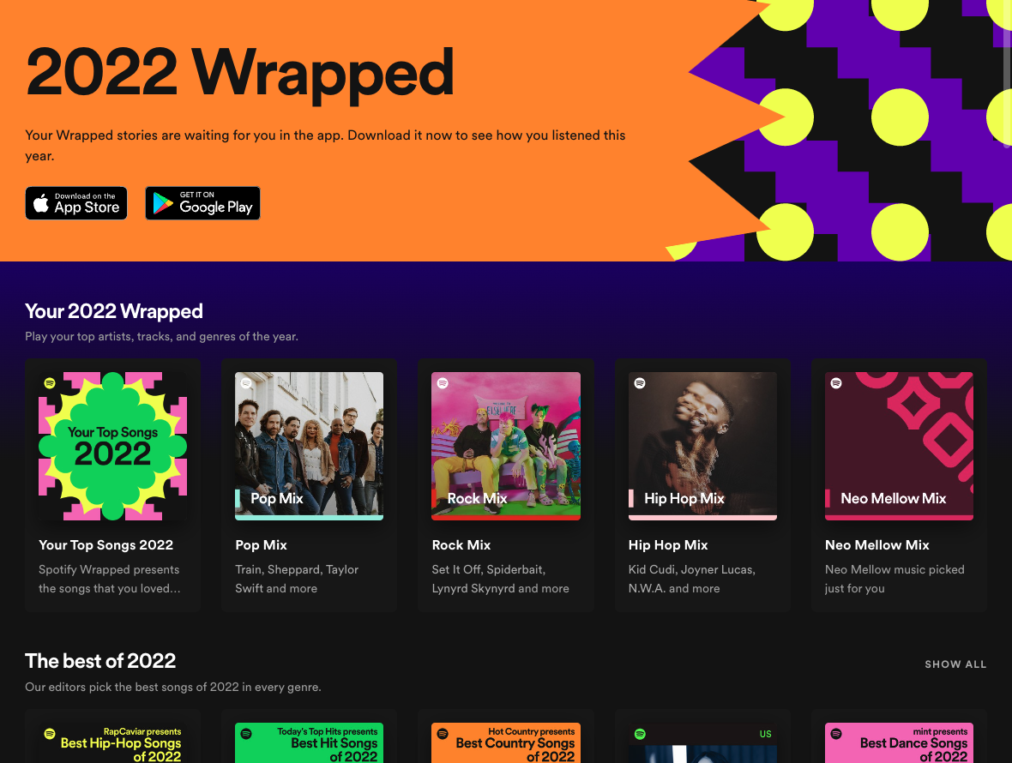
Spotify 2022 Wrapped…
Notes:
Great recommendation is a selling point and helps differentiate… music is a commodity anyone can build a giant library
… Spotify needs something to differentiate itself…

Slide 9

Spotify and Big Data to Differentiate

Slide 10

Spotify and Big Data to Differentiate

Slide 11

Spotify and Big Data to Differentiate

Slide 12

Spotify and Big Data to Differentiate

Slide 13

Spotify and Big Data to Differentiate

Slide 14
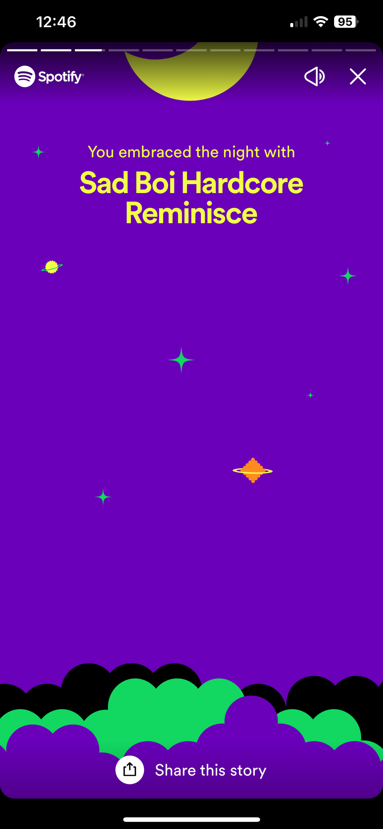
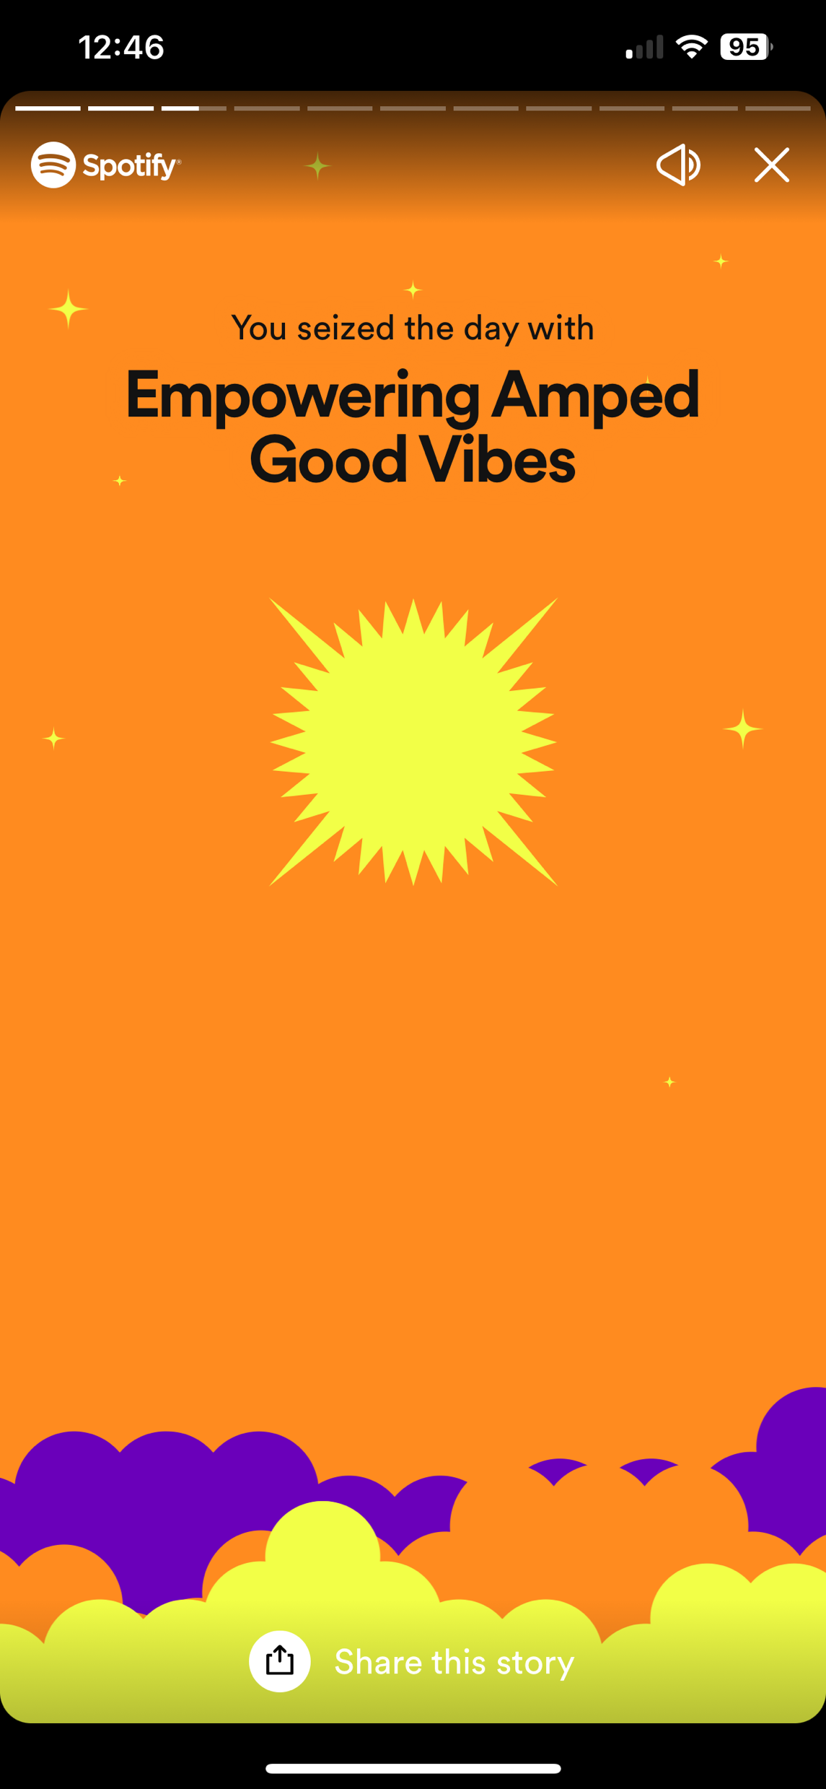
Spotify and Big Data to Differentiate

Slide 15
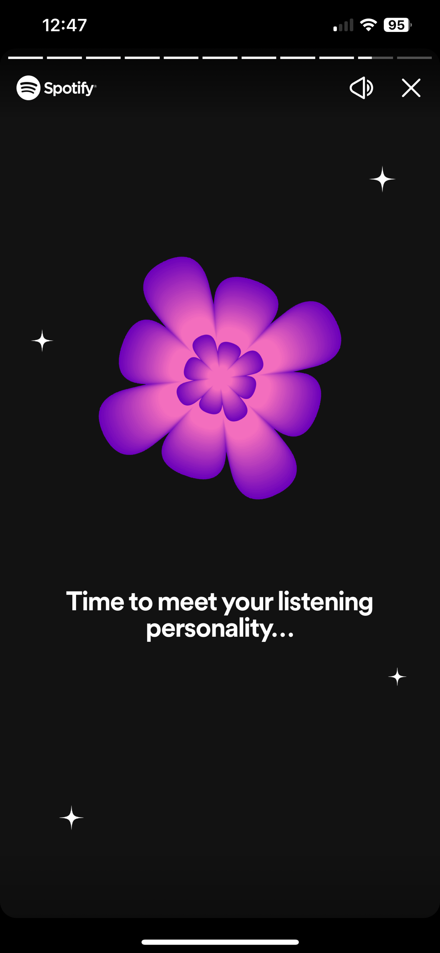
Spotify and Big Data to Differentiate

Slide 16
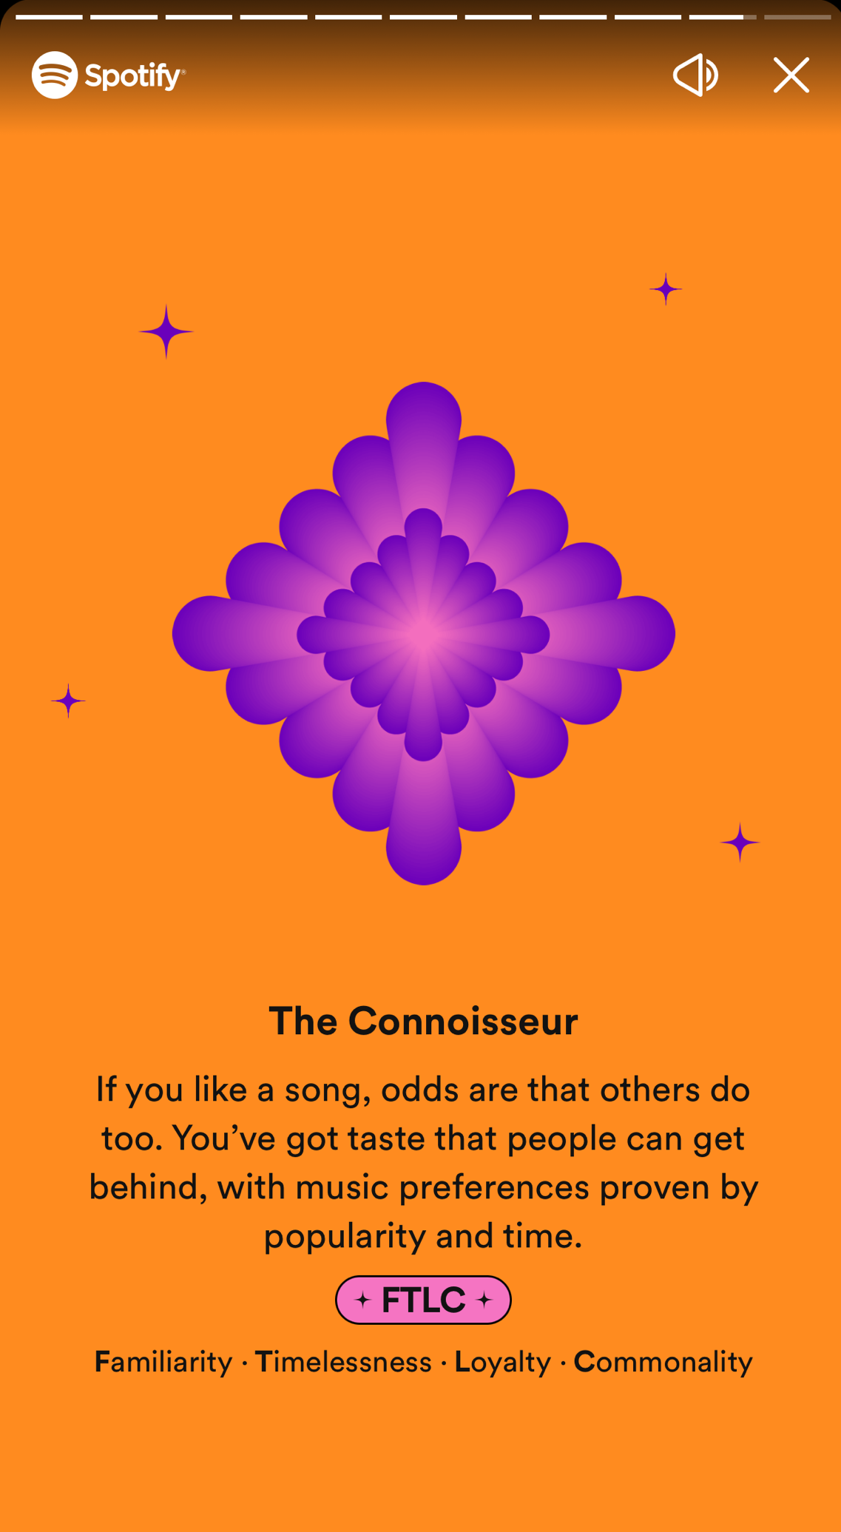
Spotify and Big Data to Differentiate

Slide 17
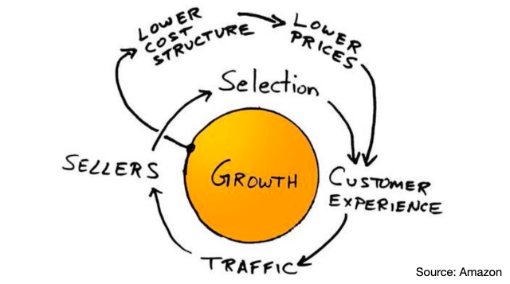
Why invest in music Recommendations?
Amazon Flywheel:
https://www.youtube.com/watch?v=5jcDlGn-tZA
Notes:
Economies of Scale
2001 “virtuous cycle” when Jeff Bezos first sketched Amazon’s marketing strategy
Bigger, leverage website, fulfillment, economies of scale to lower cost per unit Also allow detail papers to sell as well, better customer experience and sellers bring selection; fast track
collaborative filtering gets better with more users…

Slide 18
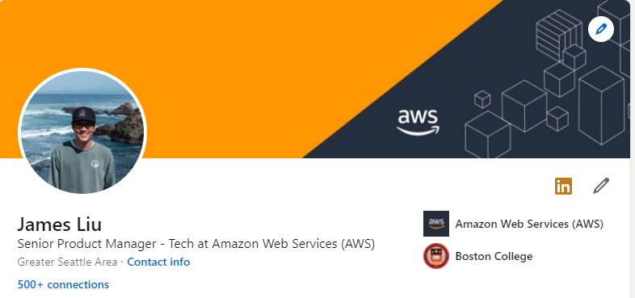
Questions?
https://www.linkedin.com/in/jamesAWS /

